Slide 1

LLM Agent Overview Part 1
Jiaxuan You
Assistant Professor at UIUC CDS
CS598: Topics in LLM Agents, 2025 Spring
https://github.com/ulab-uiuc/CS598-Topics-in-LLM-Agents

Slide 2
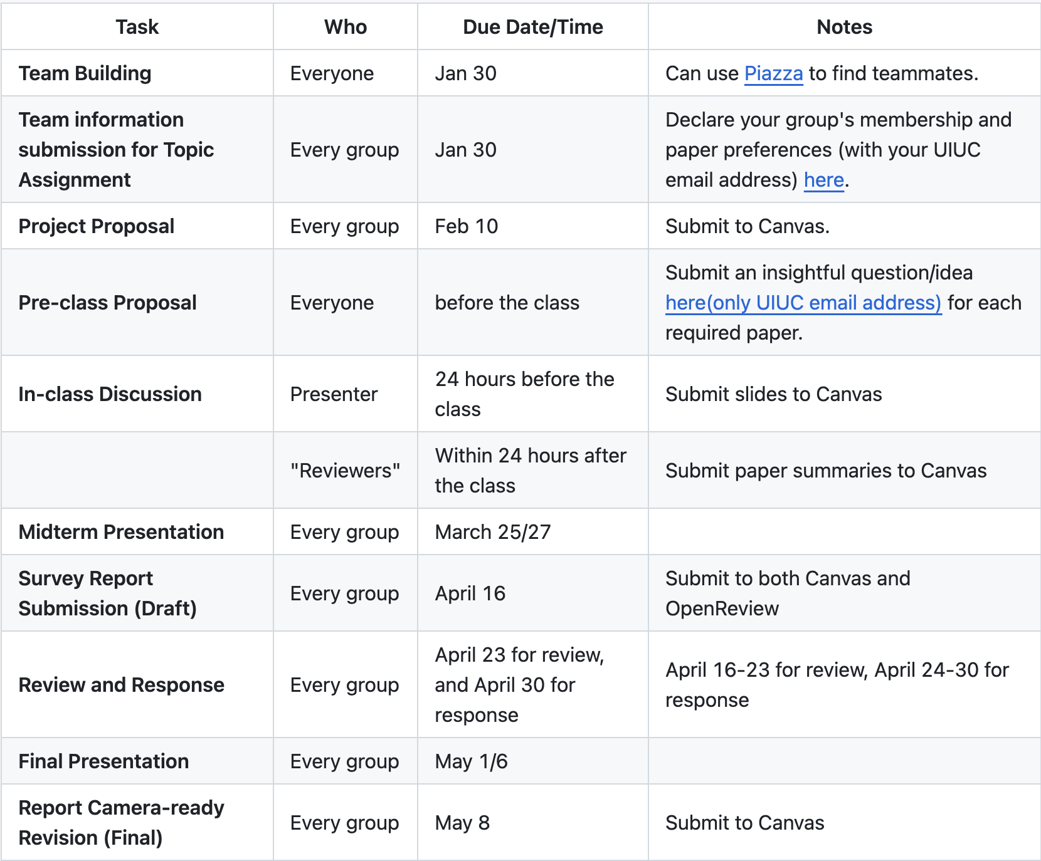
Reminders
Start finding teammates now!
(Or we will assign teammates for you)
Declare your group membership and preference by Jan 30
https://github.com/ulab-uiuc/CS598-Topics-in-LLM-Agents

Slide 3
Announcements
Course GitHub is out (https://github.com/ulab-uiuc/CS598-Topics-in-LLM-Agents)
GitHub: All the information of the course will be shared
Canvas: Important reminders for registered students, submissions for grading
Piazza: Discussions (and teammate finding)
Particularly, in the course GitHub, please keep track of
Course schedule
Summary of deadlines
We will try to remind most of the deadlines (and annouce any necessary changes)

Slide 4
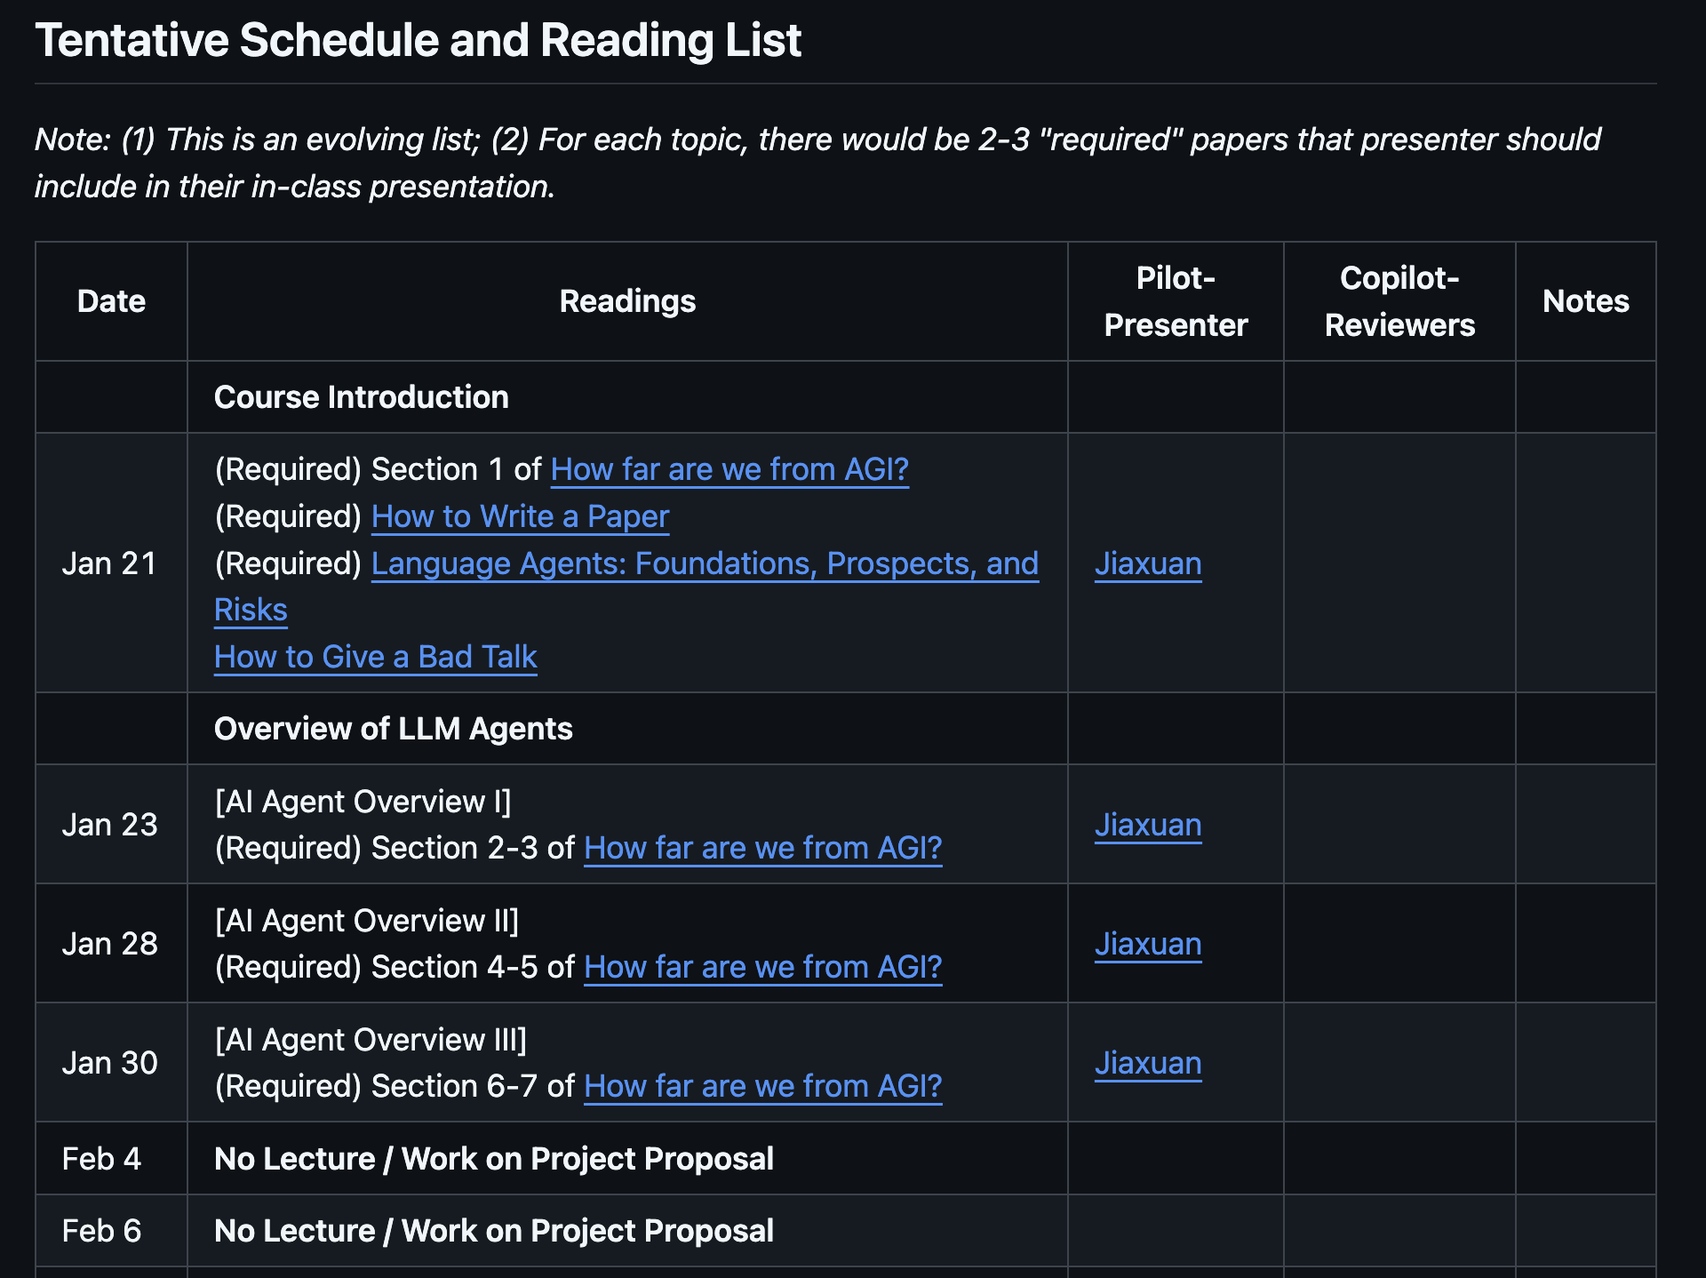
Announcements
Assignments will be out by Jan 31
For pilot and copilot groups, please start working on the presentation and reviews & panel at least 10 days ahead of lecture
Let TA/Instructor know ASAP if you have questions

Slide 5
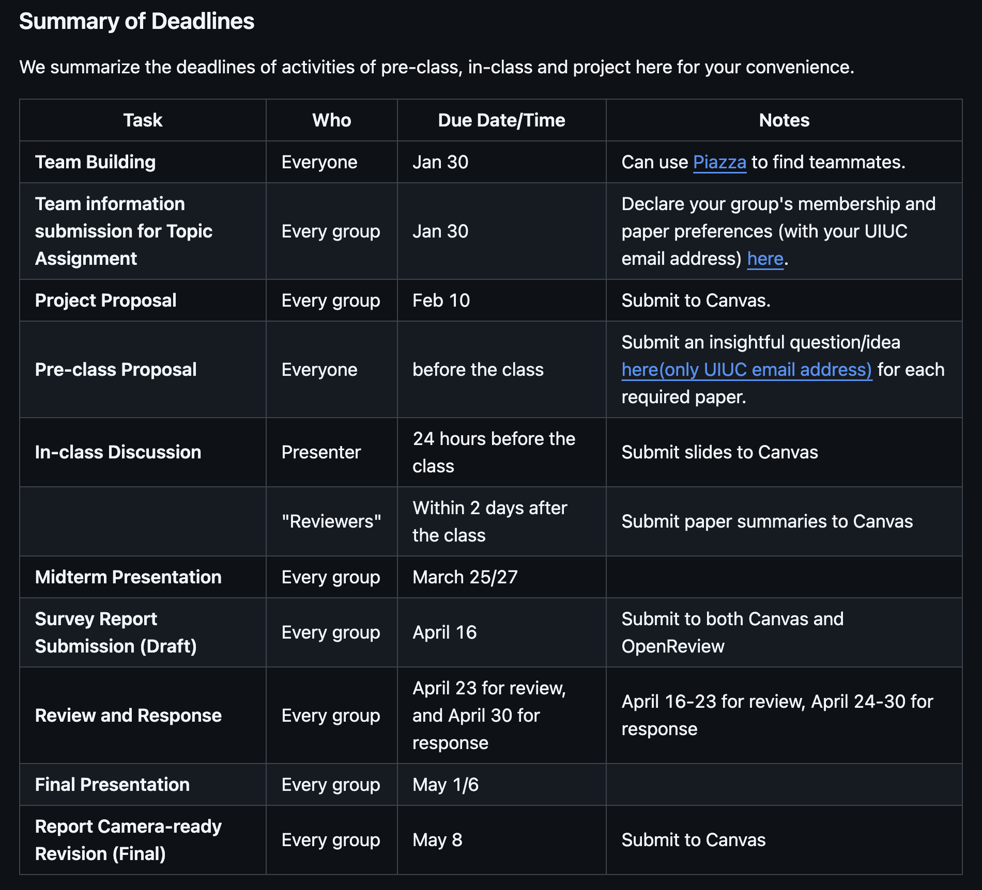
Announcements
Remember to check all the deadlines!

Slide 6

Recap: From LLMs to LLM Agents
Input
Output
Tokens
LLM
Tokens
LLMs
(Text & other modalities)
(Text & other modalities)
Perception
LLM
LLM Agents
Tokens
Actions

Slide 7

Next: Overview of AGI (LLM Agent)
Published in TMLR 2024
Project website: https://github.com/ulab-uiuc/AGI-survey
This paper is a living document. We warmly welcome feedback from the community and plan to update the paper annually. Contributors on the project website will be gratefully acknowledged in future revisions.
Bonus for this course: extra 1% of total grade if you create a meaningful Issue/PR, plus extra 1% if your PR is merged. Up to 3% of total grade. Contact our TA if you believe you have qualified.

Slide 8
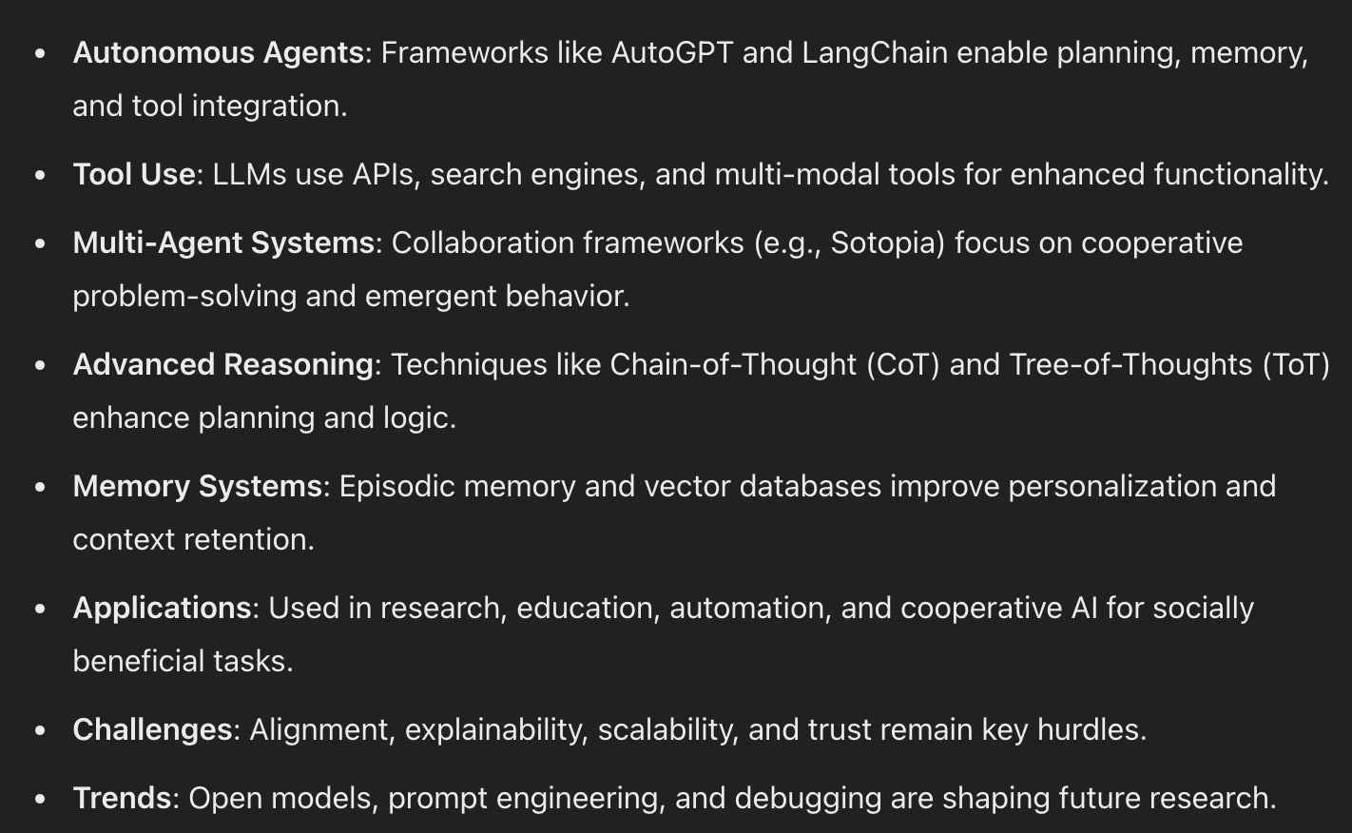
Overview of LLM Agent – By ChatGPT
Can you give an overview of state-of-the-art LLM agent research?
Nice, but not very structured
Tool, memory are very specific topics
Duplication of concepts
Missing emphasize of key topics like alignment and safety

Slide 9
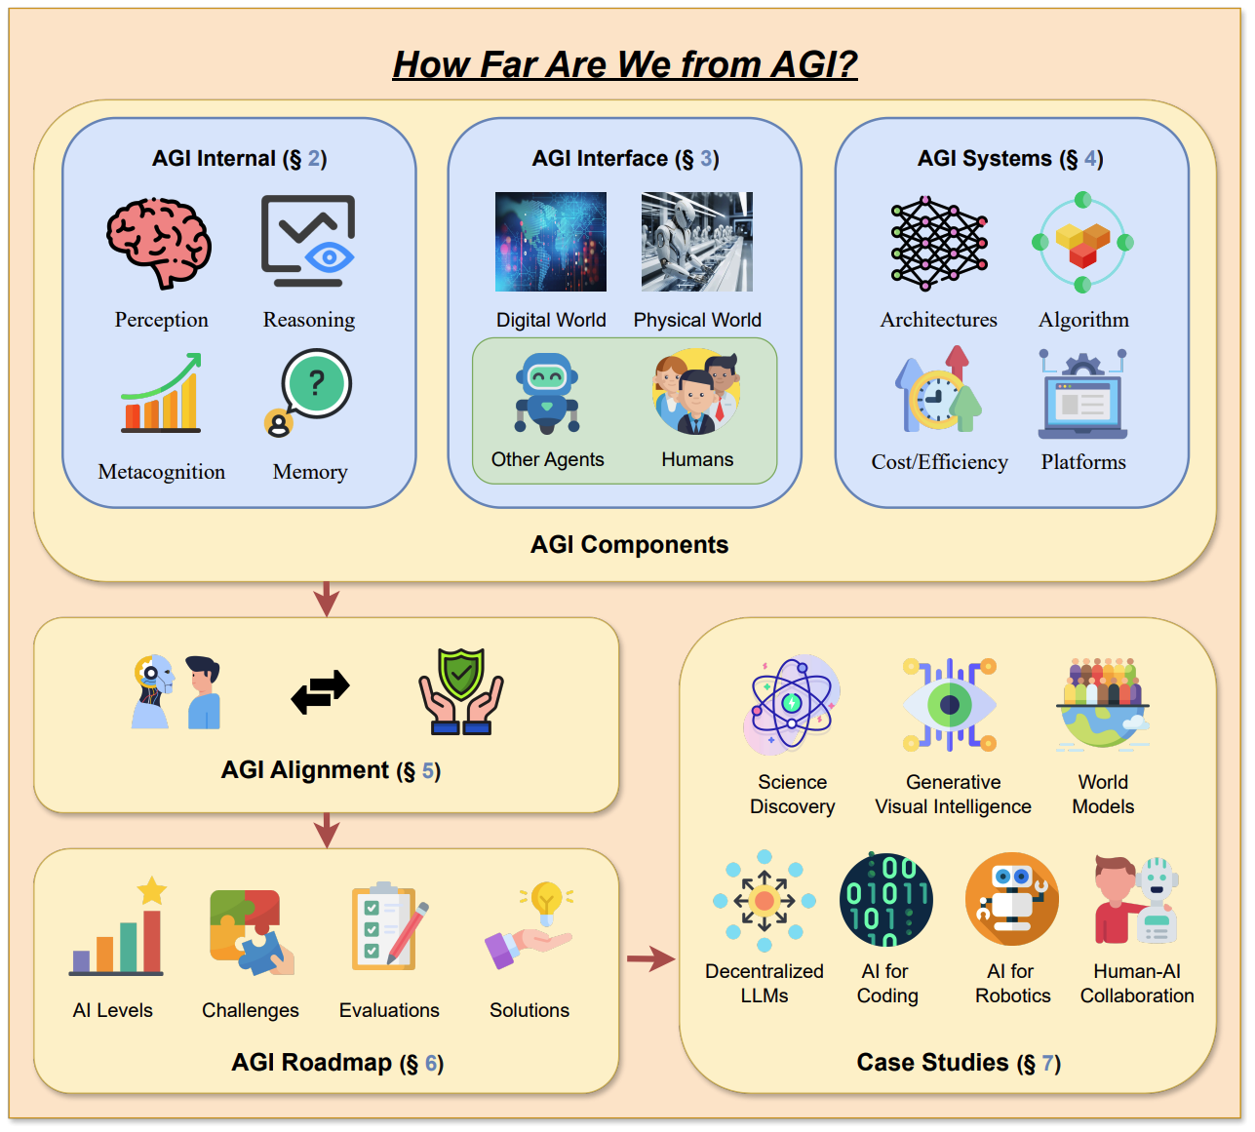
A Framework for LLM Agent Research

Slide 10
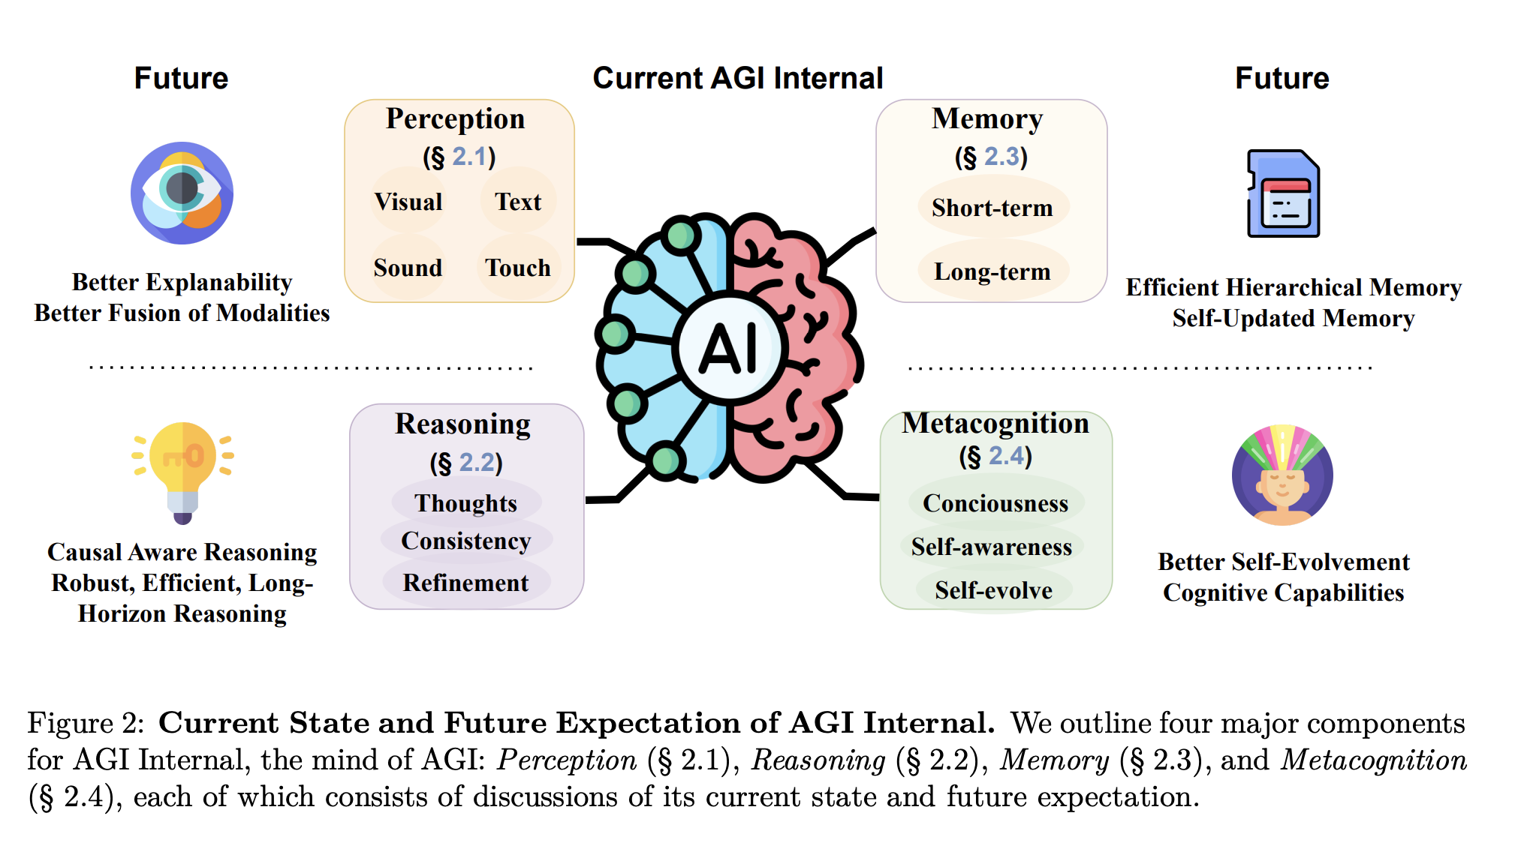
AGI Internal

Slide 11




LLM Perception
How do we let LLM understand a multi-modal world?
External: representation of modalities
Internal: model architecture for modalities
Perception
LLM
Tokens?

Slide 12
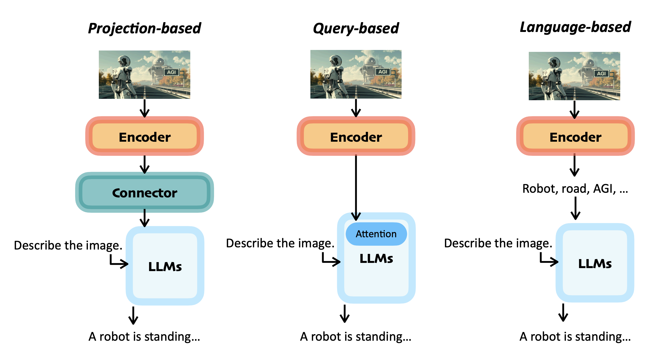
LLM Perception: External Handling of Modalities

Slide 13
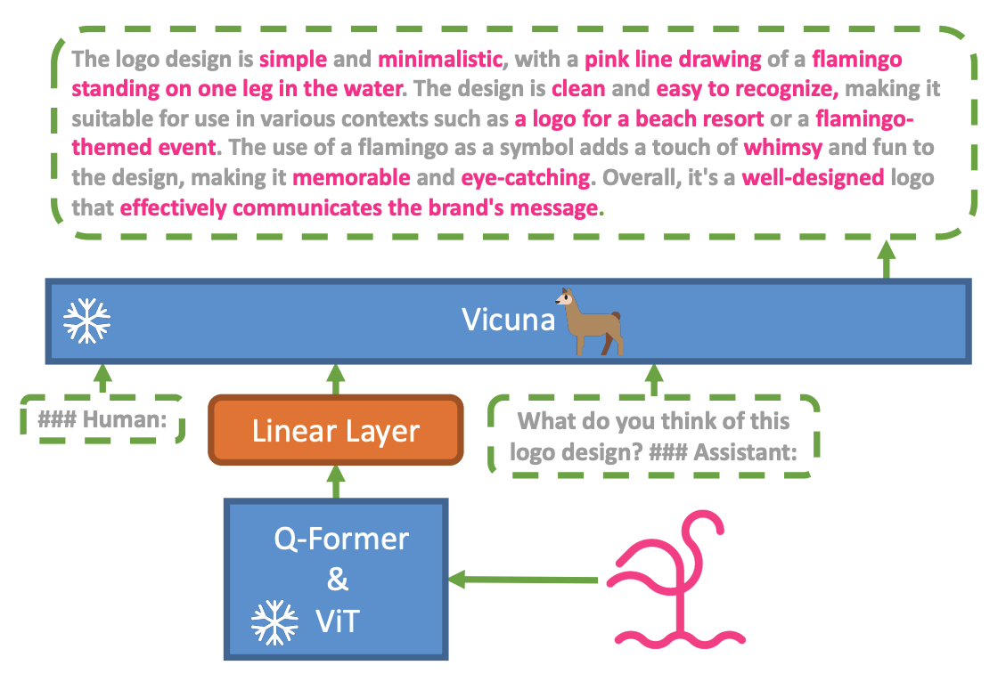
LLM Perception: Projection-based Example
Minigpt-4: Enhancing vision-language understanding with advanced large language models

Slide 14
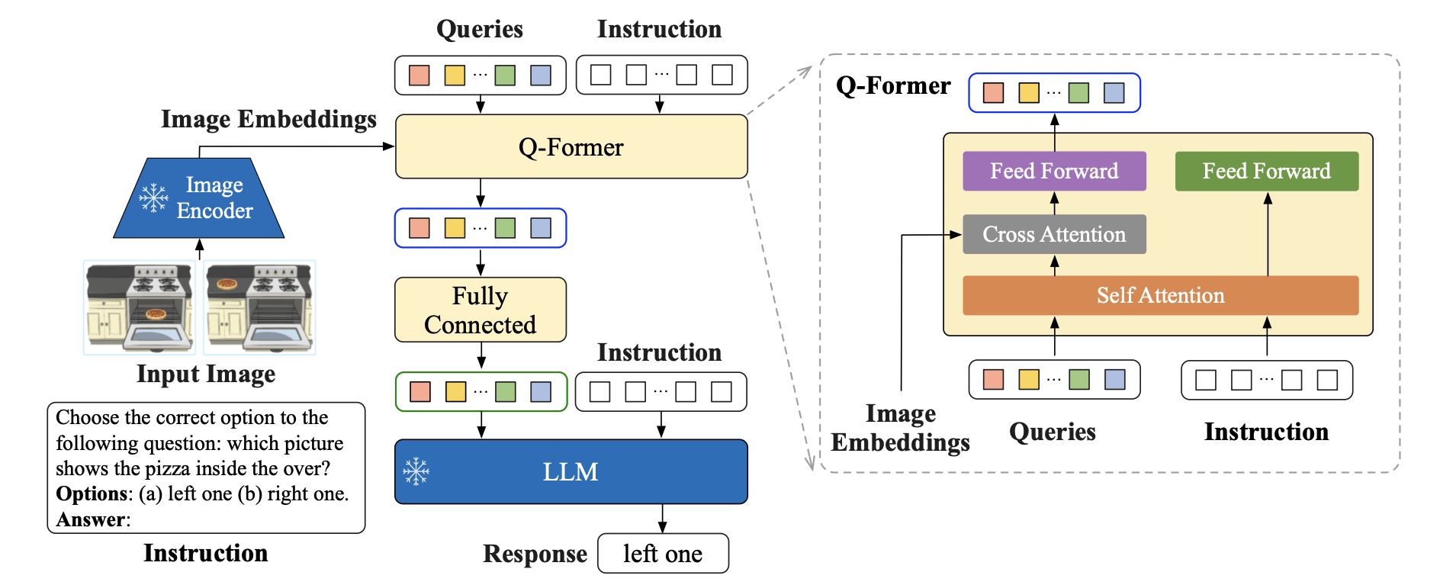
LLM Perception: Query-based Example
InstructBLIP: Towards General-purpose Vision-Language Models with Instruction Tuning

Slide 15
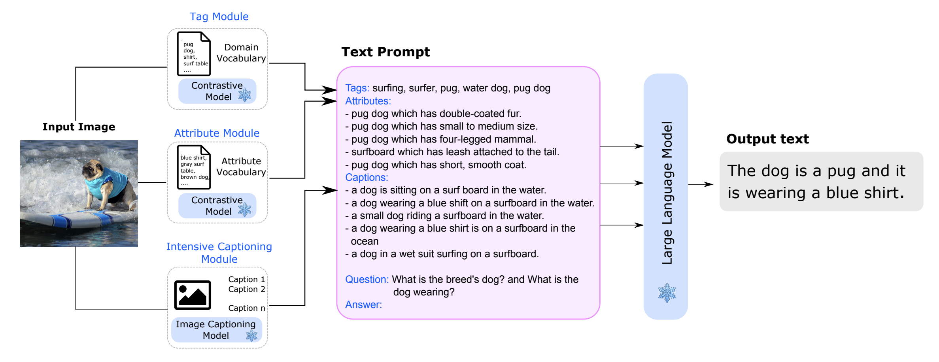
LLM Perception: Language-based Example
Towards Language Models That Can See: Computer Vision Through the LENS of Natural Language

Slide 16
LLM Perception: Discussions
🌟Discussions: Can we tokenize everything? Are there type of data that cannot (or not feasible to) be tokenized?
Perception
LLM
Tokens?

Slide 17
LLM Reasoning
Navigating through thoughts
CoT->ToT->GoT
Self-consistent reasoning
Prompting strategy for enhanced reasoning
“Think” token, Reflection, …
Planning
Reflection
Tool integration

Slide 18
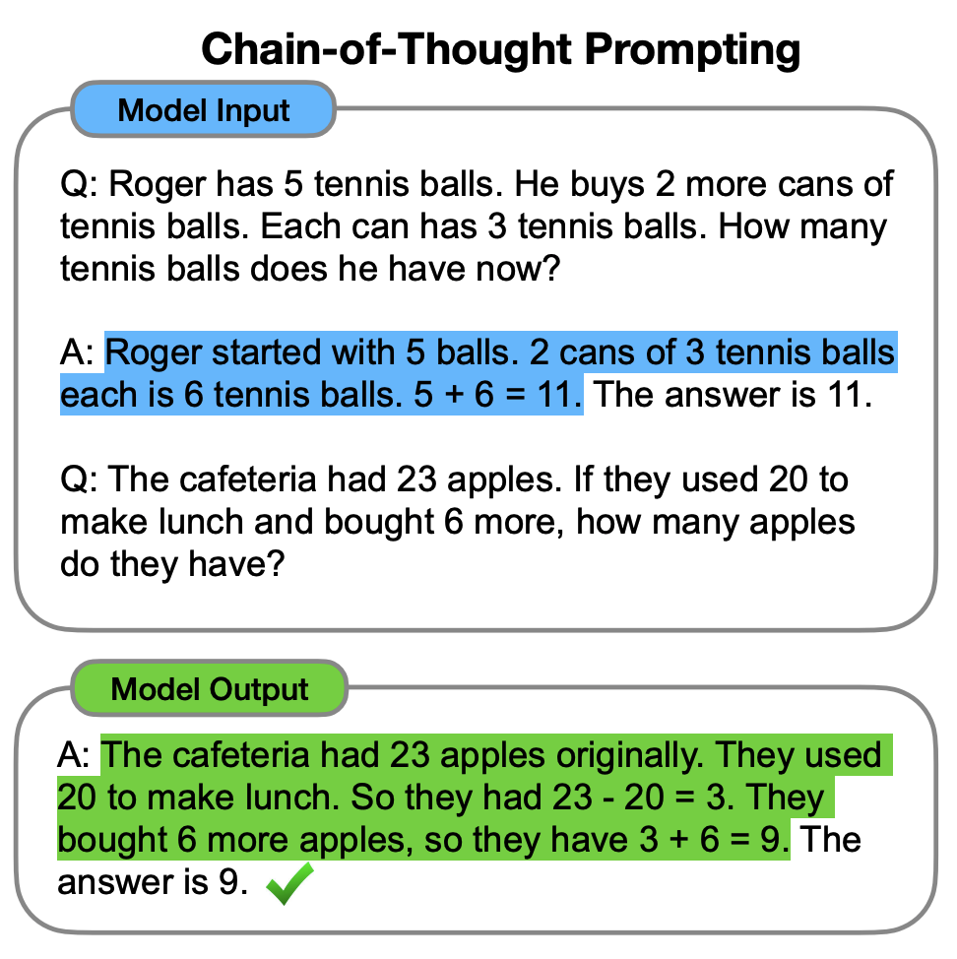
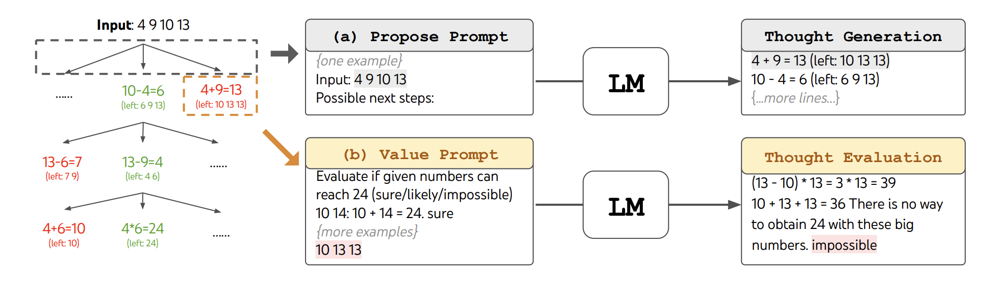
LLM Reasoning: Thought Organization
Chain-of-Thought Prompting Elicits Reasoning in Large Language Models
Tree of Thoughts: Deliberate Problem Solving with Large Language Models

Slide 19
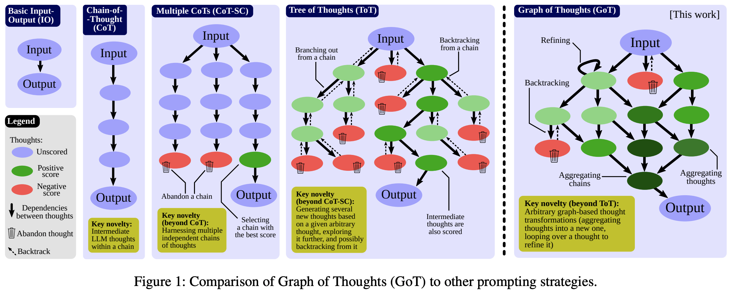
LLM Reasoning: Thought Organization
Graph of Thoughts: Solving Elaborate Problems with Large Language Models

Slide 20
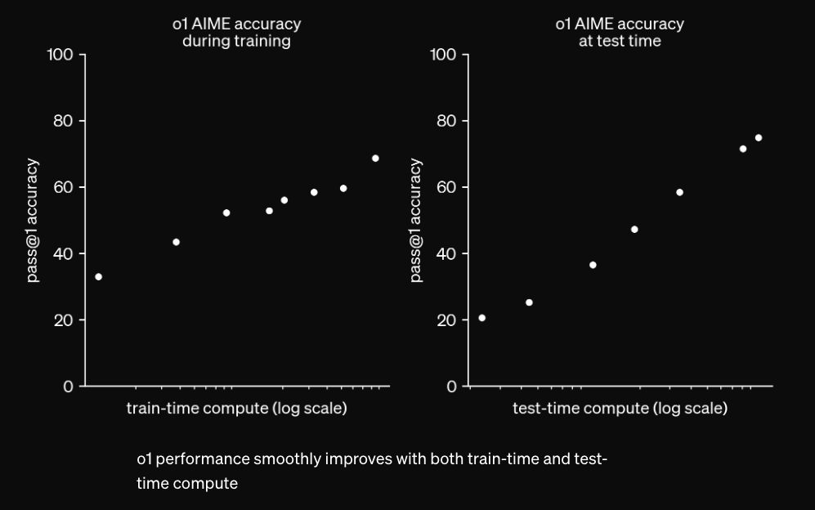
OpenAI o1: Impressive LLM Reasoning Milestone

Slide 21
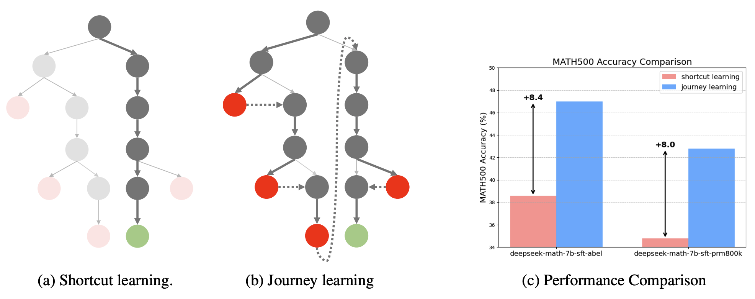
OpenAI O1: Distill Tree Search into LLM (?)
O1 Replication Journey: A Strategic Progress Report

Slide 22
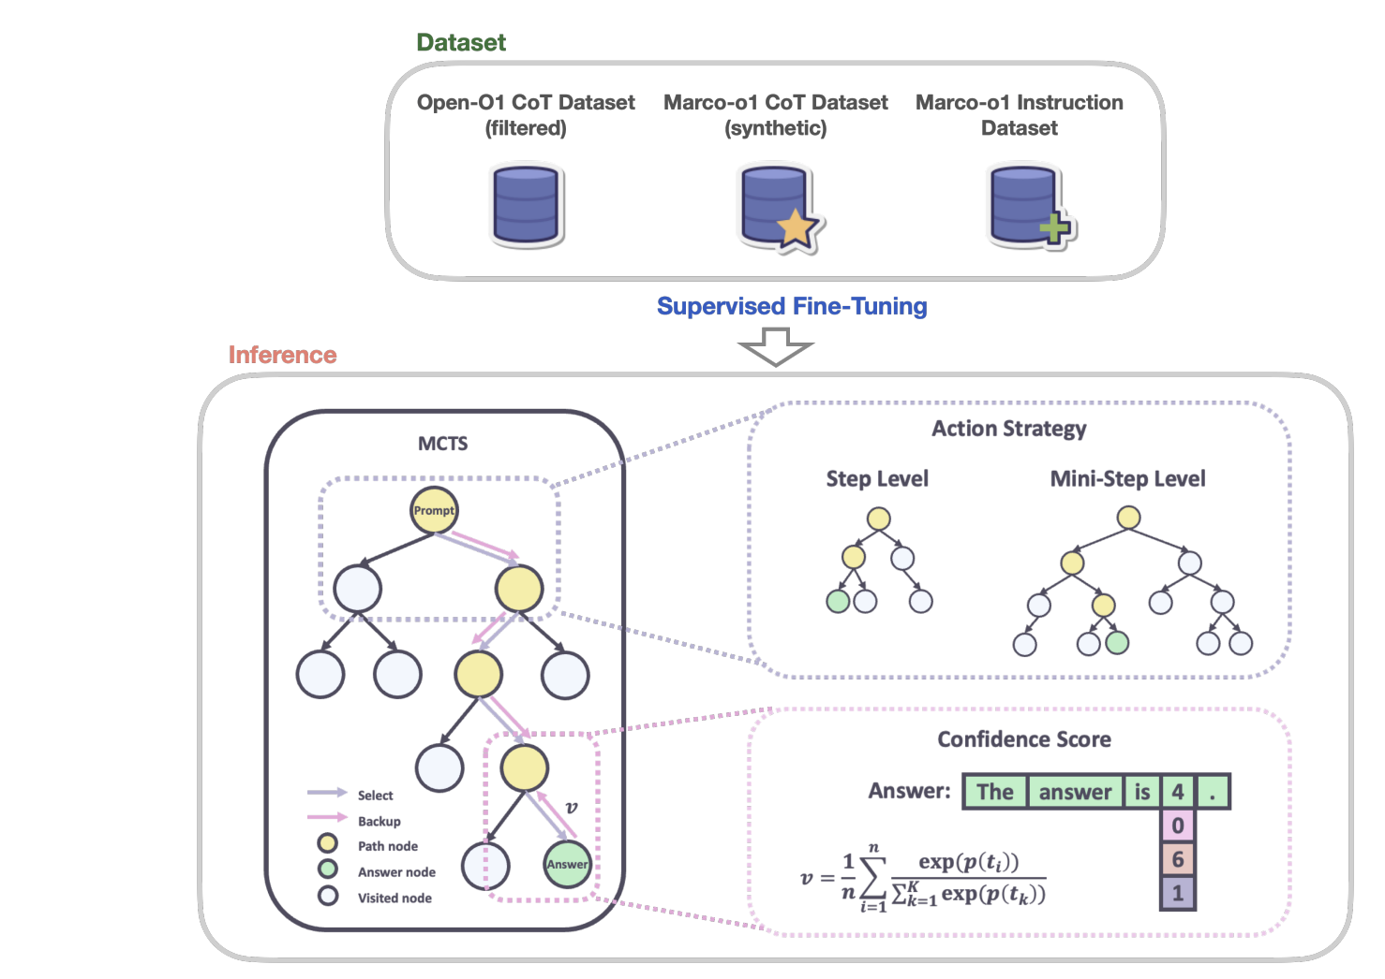
OpenAI O1: Distill Tree Search into LLM (?)
Marco-o1: Towards Open Reasoning Models for Open-Ended Solutions

Slide 23
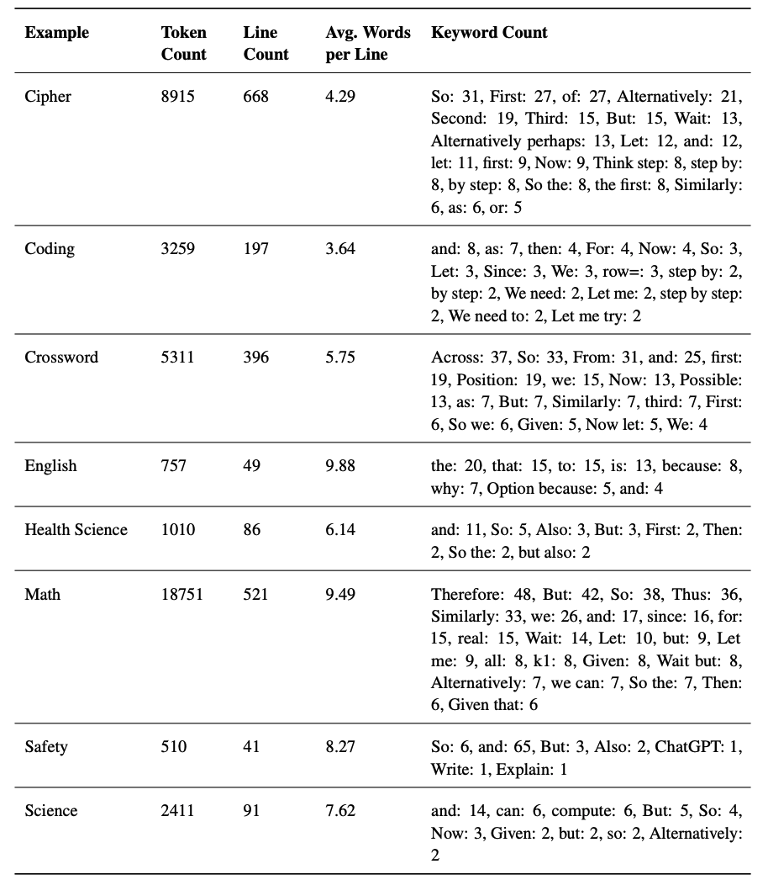
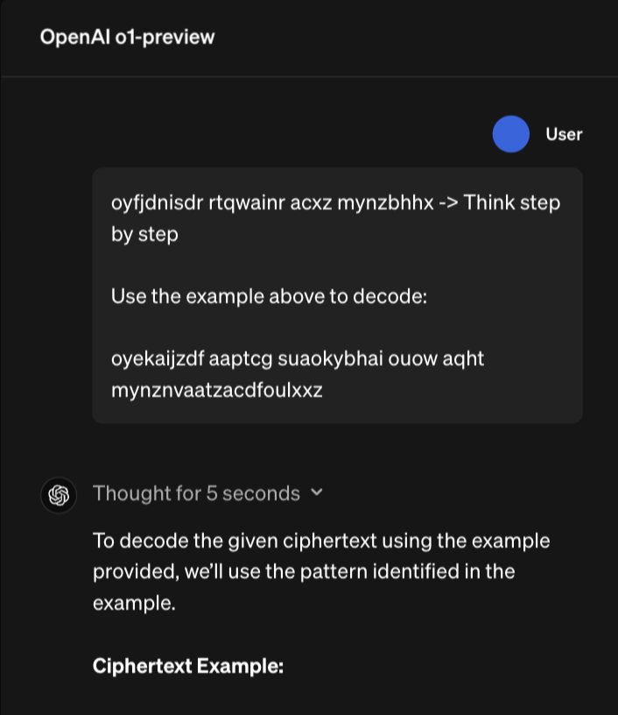
O1: A Funny Observation
https://openai.com/index/learning-to-reason-with-llms/
Analysis of original O1 thoughts (Until Nov 2024)
Latent thoughts are gone… (Jan 2025)

Slide 24
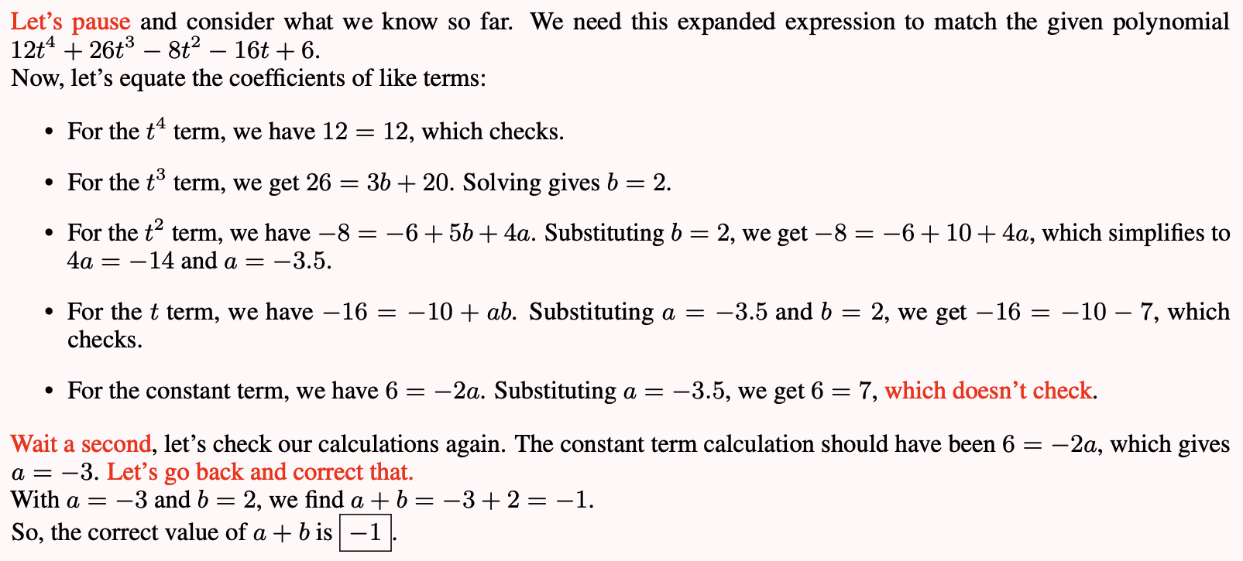
Original O1-style Thoughts
O1 Replication Journey: A Strategic Progress Report

Slide 25
LLM Reasoning: Discussion
🌟Discussion: Do you believe explicit search or implicit thought is preferred in reasoning? “System-1” & “System-2” reasoning

Slide 26
LLM Memory
Memory management
Short-term - in-context, long-context LLM
Long-term – retrieval augmentation
Memory representation
Text or parameters/embeddings

Slide 27
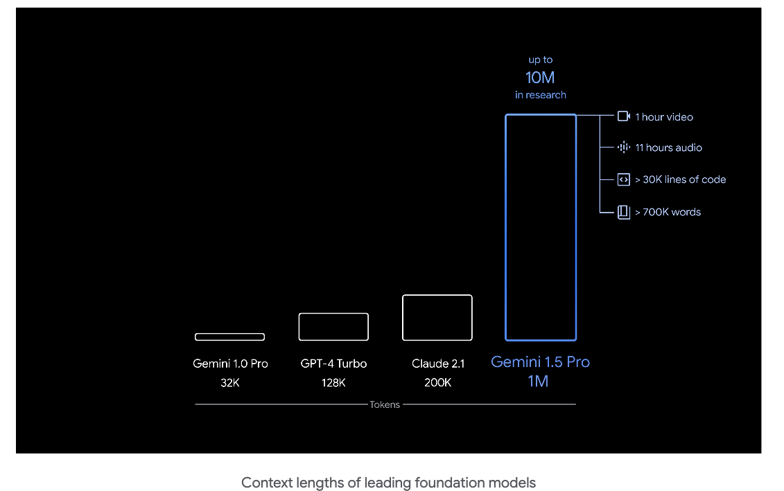
LLM Short-term Memory: Long-context LLM

Slide 28
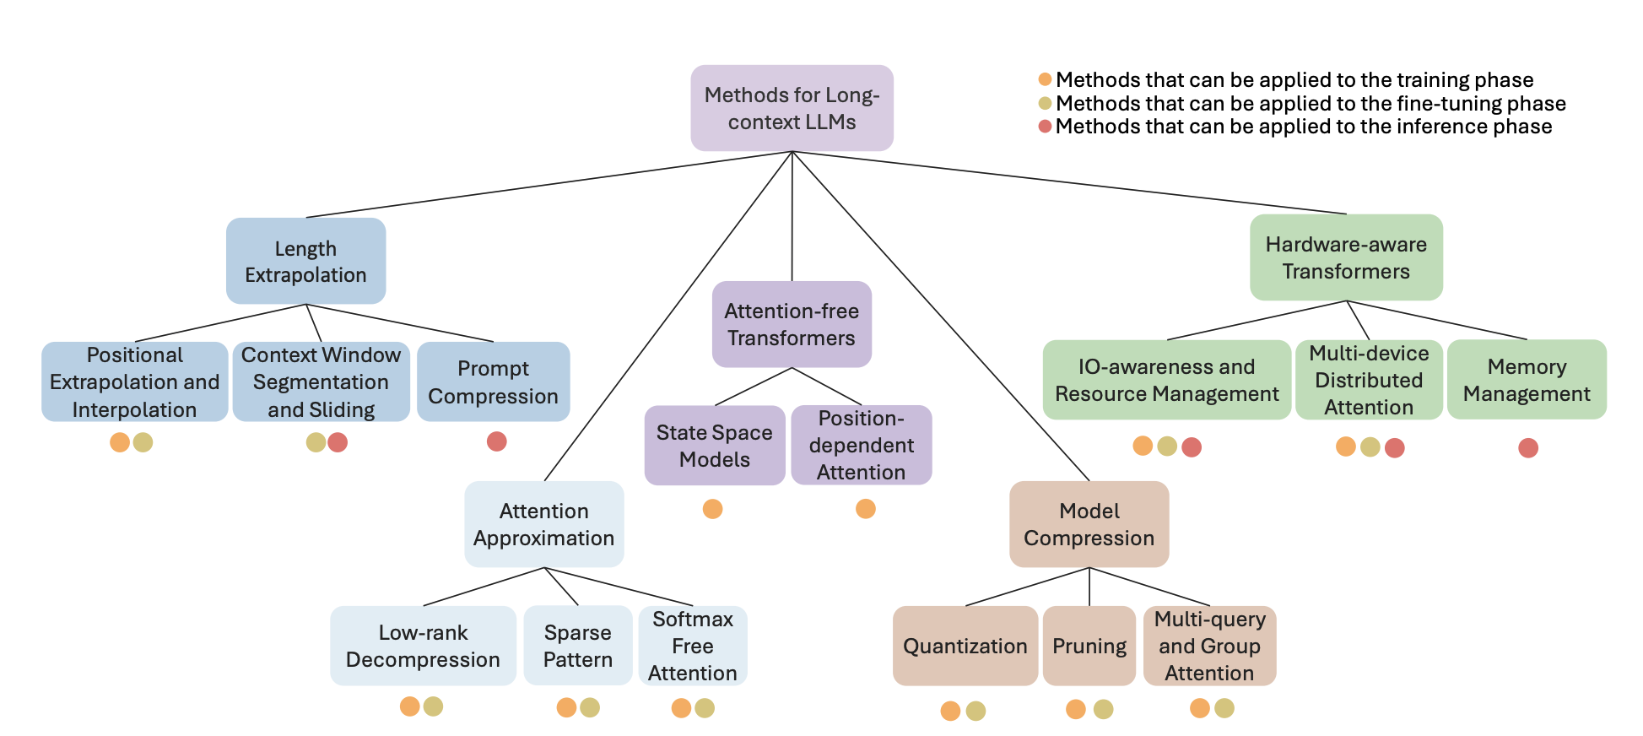
LLM Short-term Memory: Long-context LLM
Beyond the Limits: A Survey of Techniques to Extend the Context Length in Large Language Models

Slide 29
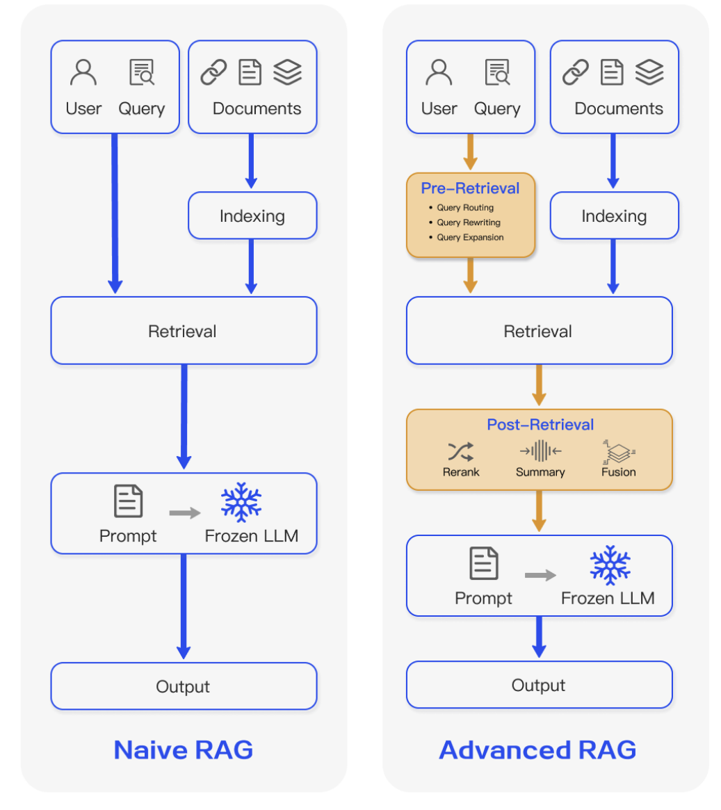
LLM Long-term Memory: RAG
Retrieval-Augmented Generation for Large Language Models: A Survey

Slide 30
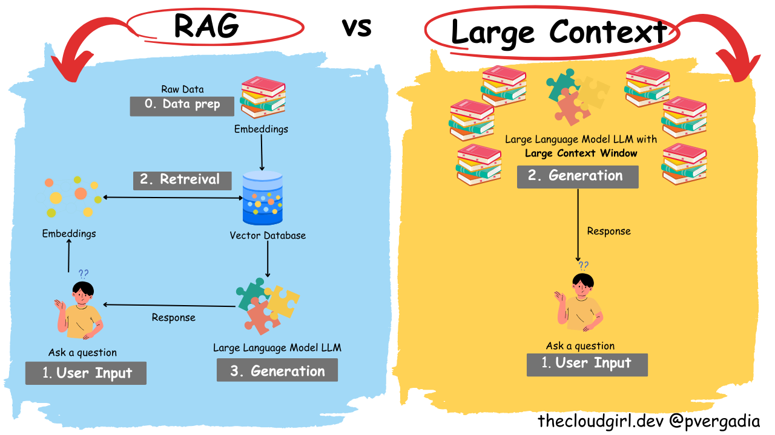
LLM Memory: Discussion
🌟Discussion: Do you believe long-context LLM is the solution to everything? How do we balance long-context and RAG? (How do we balance short and long term memory)

Slide 31
Summary: AGI Internal

